Slide 1


POOLMATE
MCA MINI PROJECT | FINAL PRESENTATION
Web-Based Carpooling Platform
Student
Sandeep Kumar VS
Register / Roll No.
MLM25MCA2046
Department
Department of Computer Applications (DCA)
College / University
Mangalam college of engineering Ettumanoor
Academic Year
2025–2027
Project Guide
Ms. Anjaly Sajeev, Assistant Professor
Course
MCA (S3)

Slide 2



Introduction
WHAT IT IS
How users work with POOLMATE
POOLMATE is a web-based carpooling platform where registered users publish, search for and request rides. It currently focuses on four-wheeler ride sharing.
Publish a ride
Enter origin, destination, time of leave and available seats.
BACKGROUND
Carpooling lets people travelling the same way share one vehicle and its cost. Arranging this informally is hard and offers little trust between strangers.
Search for rides
PURPOSE
Find published rides using origin and destination.
One simple platform to publish and find rides, manage requests and build trust through profiles and reviews.
IMPORTANCE
Request to join
Shared travel cost, easier coordination and, when rides are genuinely shared, fewer vehicles on the road.
Send a request; the publisher accepts or declines it.

Slide 3
Abstract
Overview
POOLMATE is a Django-based web application for four-wheeler carpooling. Registered users publish, search for and request rides.
Problem
No simple, dedicated platform lets individuals share rides and manage requests, notifications and trust between co-travellers.
Solution
Ride publishing and search, a request–notification–accept/decline workflow, profiles, reviews and payments, plus an admin module.
Technologies / Method
HTML, CSS, JavaScript, AJAX; Python (Django); SQLite. Developed iteratively in sprints.
Outcome
A working web application covering the documented modules. Quantitative evaluation was not part of the supplied project material.

Slide 4



Problem Definition
Individuals lack a simple, dedicated web platform to publish and find four-wheeler rides and to manage ride requests with trust.
Need: a structured ride-publishing and ride-request platform.
Why coordination is difficult
No dedicated platform
No simple matching
No request workflow
No trust mechanism
No easy way to share four-wheeler rides for daily or occasional travel.
Publishers and seekers are hard to match on origin and destination.
No structured way to handle requests, accept/reject and notify users.
No review or rating system to build safety among co-travellers.

Slide 5
Objectives
Specific objectives
MAIN OBJECTIVE
Build a web platform that lets users share four-wheeler rides conveniently and at lower cost.
1
Reduce travel costs by sharing rides with users heading the same way.
2
Save time by matching publishers and seekers on origin, destination and time.
3
Reduce traffic congestion and fuel consumption through shared travel.
4
Promote a trustworthy community through reviews and profile management.
EXPECTED OUTCOME
5
Make publishing, searching and booking of rides easy.
A working platform where users publish, search, request and confirm rides, with notifications, reviews and payments.
Benefits to users
Shared travel cost
Convenient coordination
Time saving
Trusted co-travellers

Slide 6
Existing System
BlaBlaCar
Uber Pool / Ola Share
Quick Ride
FOCUS
FOCUS
FOCUS
Widely used for intercity carpooling.
Cab-sharing with company-owned drivers.
Popular carpooling app in India.
GAP
GAP
GAP
Not localized for short, daily intra-city commutes.
Not peer-to-peer ride sharing between regular users.
Lacks a strong review/rating system for trust between co-travellers.
General gaps in existing apps
How POOLMATE differs
No integrated request – notification – accept/decline workflow.
No unified profile and review system.
No simple publish-and-search model in a single platform.
Peer-to-peer four-wheeler sharing with one integrated flow: publish → search → request → accept/decline → notify.

Slide 7



Proposed System
Ride publishing
Ride searching
Ride requests
Origin, destination, time of leave and available seats.
Search published rides by origin and destination.
Seekers send requests; publishers accept or decline.
Notifications
Profiles and reviews
Payments
Publishers and seekers are notified of requests and decisions.
Profile with preferences; reviews to build trust.
Payment functionality for booked rides.
IMPROVEMENTS OVER EXISTING APPS
Integrated request–notify–accept/decline workflow
Unified profile and review system
Simple publish-and-search in one platform

Slide 8
Scope of the Project
Target users
Included in the project
Possible future work
Individuals travelling by four-wheeler, daily or occasionally
Registered users who publish and/or search for rides
Administrators managing users and reviews
Application area: road travel sharing
Registration, login, profile and preferences
Ride publishing and searching (four-wheeler only)
Ride requests, notifications, accept/decline
Reviews for rides and users
Payment for booked rides
Admin module for users and reviews
NOT IMPLEMENTED
Maps / GPS integration
Real-time tracking
Mobile application
Verified identities
Single-user model: the same user can both publish and search for rides (no separate driver / passenger roles).

Slide 9
Literature Review
Title & Year | Author & Publication | Algorithm Used | Features / Methodology | Performance Metric | Result / Findings
Ride-Sharing Matching Under Travel Time Uncertainty (2022) | Xiaoming Li et al., IEEE Access | GRU + Robust Optimization + LS-SA | Travel-time prediction, ride matching, uncertainty handling | Matching rate, violation rate | Reduced violations; improved ride matching
QE-Ride (2024) | [Authors – verify], IEEE | ML + Multi-objective Optimization | QoE-based ride recommendation | Accuracy, user satisfaction | Better passenger experience
i-CAP Intelligent Carpooling (2023) | [Authors – verify], IEEE | Dynamic Ride Matching | Real-time matching and route optimization | Matching success rate | Reduced travel time
ML-based Ride Recommendation (2024) | [Authors – verify], Springer | ML + Route Optimization | Preference analysis and recommendation | Accuracy, precision | Improved recommendation quality
POOLMATE (2025) – present work | Project work | Django-based ride matching | Ride publishing, booking, authentication | Response time [not measured] | Centralized carpool web platform

Slide 10





Technologies Used
Frontend
Backend
Database
Dev Tools
Testing
HTML5
Page structure
CSS3
Styling and layout
JavaScript
Client-side behaviour
AJAX
Updates without page reload
Python
Application logic
Django
Web framework
Django ORM
Database access
SQLite
Lightweight relational store for users, rides, requests, payments and reviews
VS Code
Code editor
Git / GitHub
Version control
Unit testing
Individual modules
Integration testing
Overall system flow
Open-source, reliable and well-supported technologies keep development cost low (feasibility study).

Slide 11
Software and Hardware Requirements
Software Requirements
Hardware Requirements
Item | Requirement | Basis
Operating system | Windows 10/11 (or Linux / macOS) | Suggested
Python | Python 3.x [exact version – add] | To confirm
Django | Django [version – add] | To confirm
Web browser | Chrome / Edge / Firefox | Suggested
Database | SQLite (bundled with Python) | Confirmed
Code editor | VS Code | Confirmed
Item | Requirement | Basis
Processor | Dual-core, 2 GHz or higher | Suggested
RAM | 4 GB minimum (8 GB preferred) | Suggested
Storage | 1 GB free disk space | Suggested
Display | 1366 × 768 or higher | Suggested
Network | Internet / LAN for browser access | Suggested

Slide 12

System Architecture
USER INTERACTION
PRESENTATION LAYER
APPLICATION / BUSINESS LOGIC
DATABASE LAYER
Users
Frontend
Django Backend
SQLite
HTML5 · CSS3 · JavaScript · AJAX
Python · Django
via Django ORM
Passenger / driver (registered user)
Web browser
Administrator
Register / login
Home
Publish ride
Search ride
Ride request
My rides
Notifications
Profile & preferences
User management
Ride management
Search & filter
Ride request management
Notification service
Review & rating
Payment management
User
Ride
Ride request
Ride booking
Payment
Review
Notification
User preference
Administration (Admin panel)
External services
Manage users, rides, ride requests, reviews and payments; generate reports; system settings
Maps, SMS/OTP, payment gateway: planned, not confirmed

Slide 13
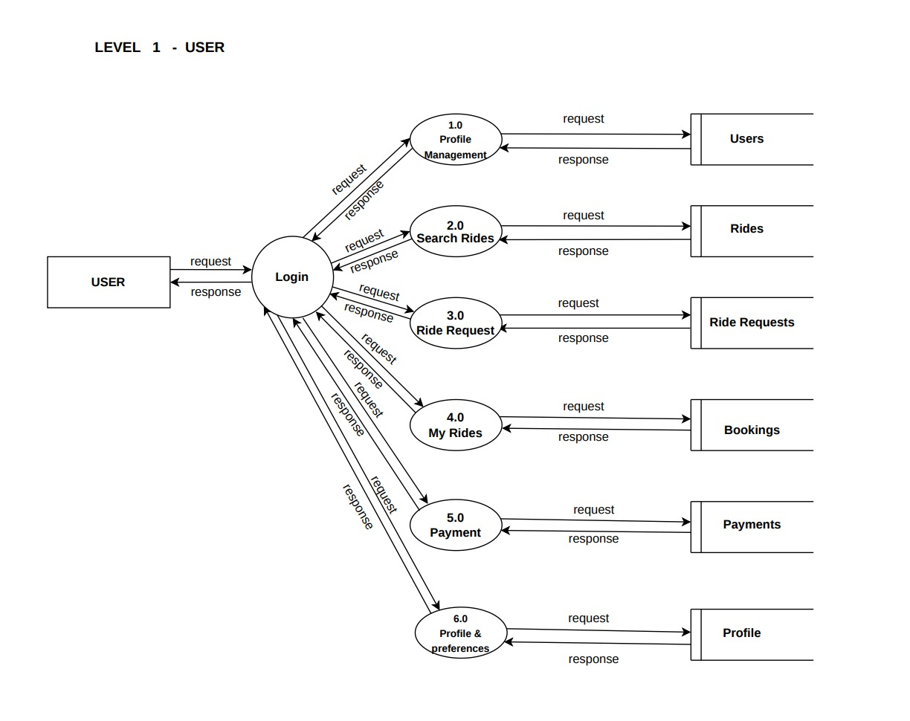
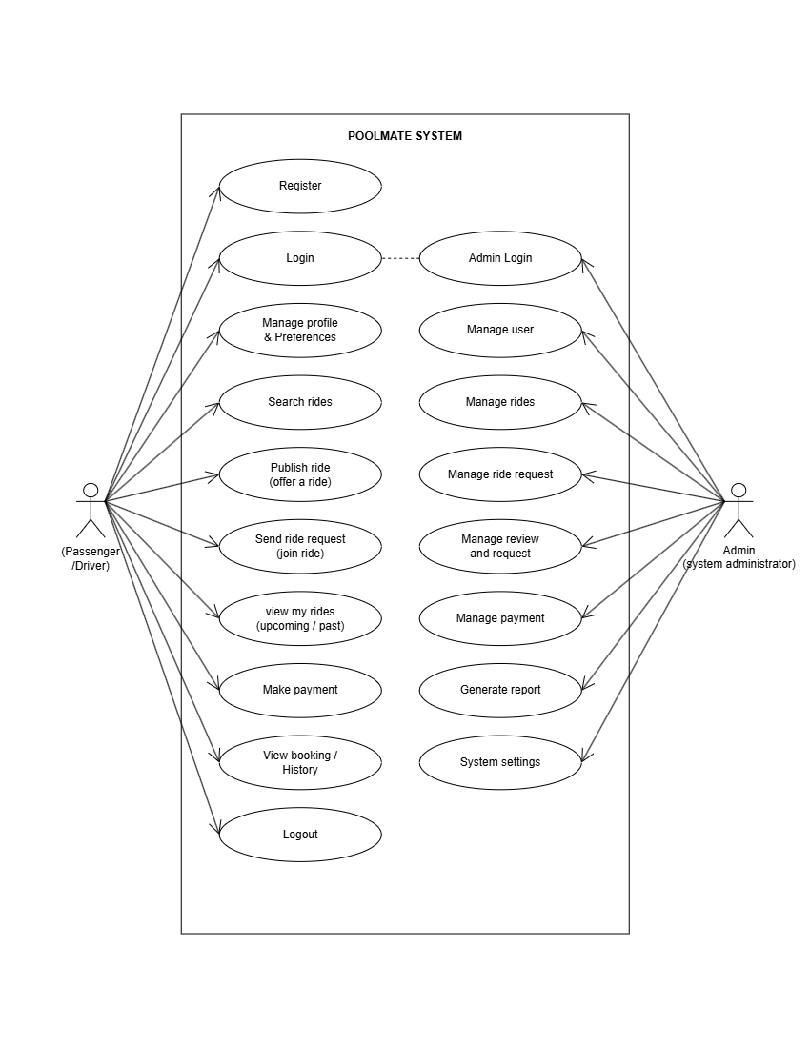
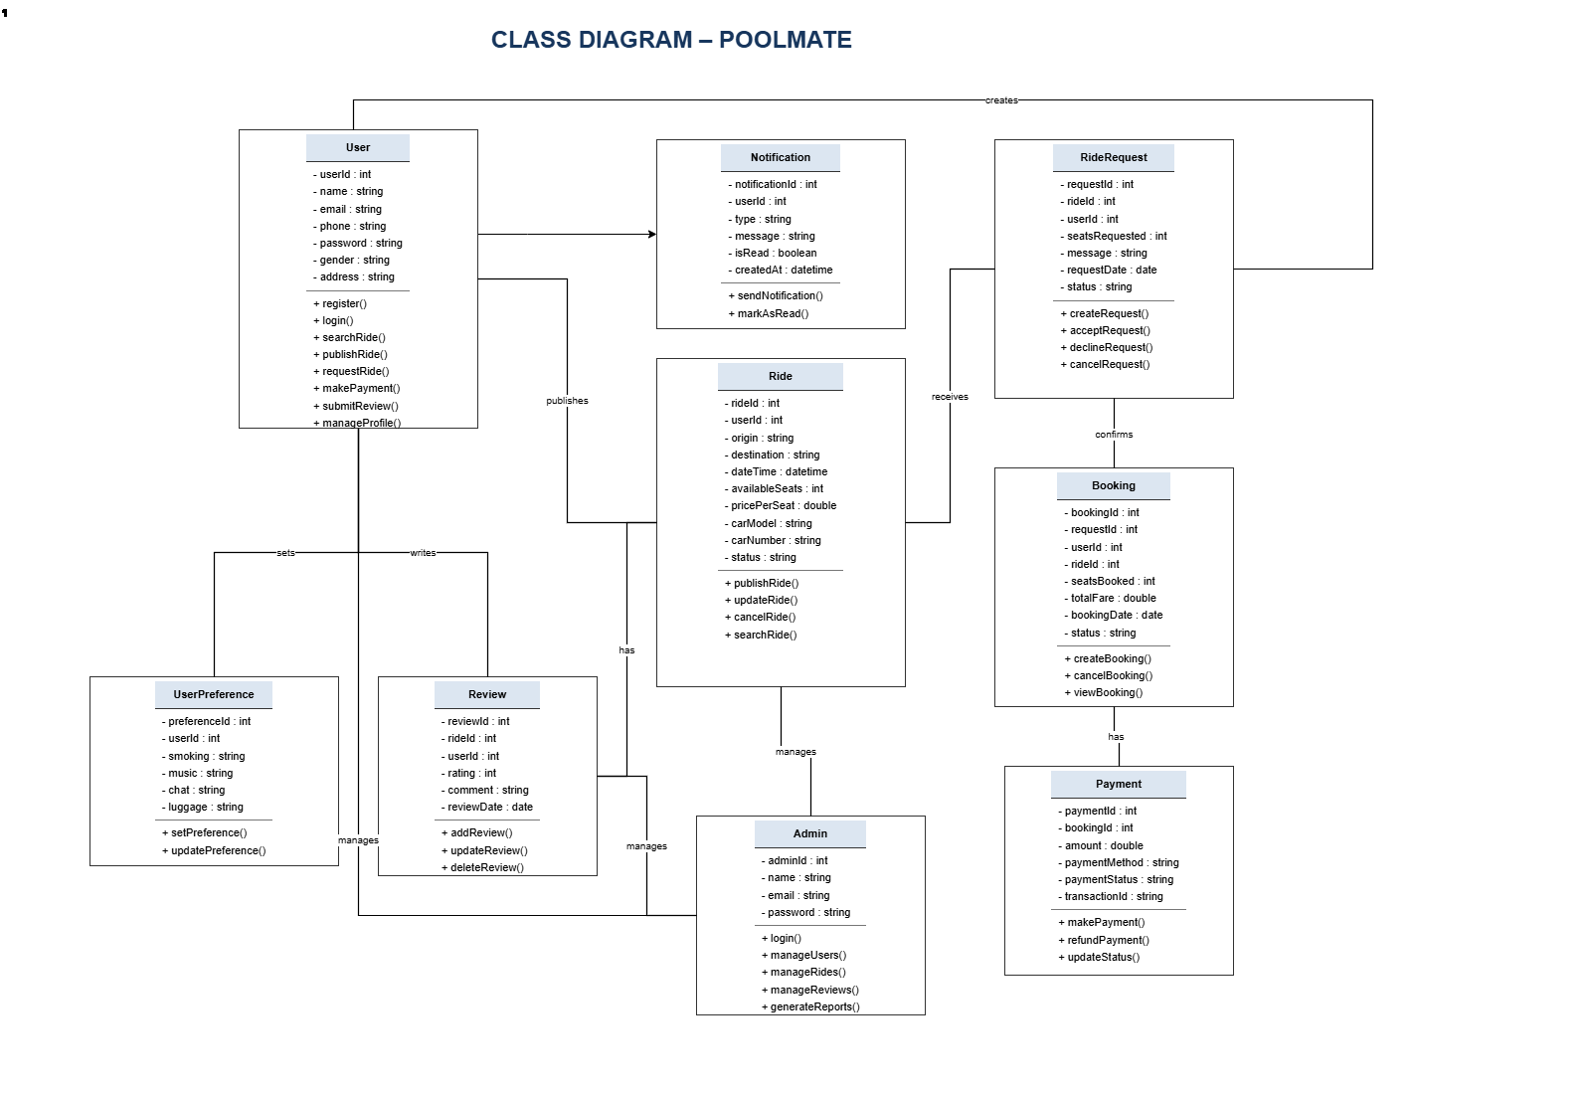
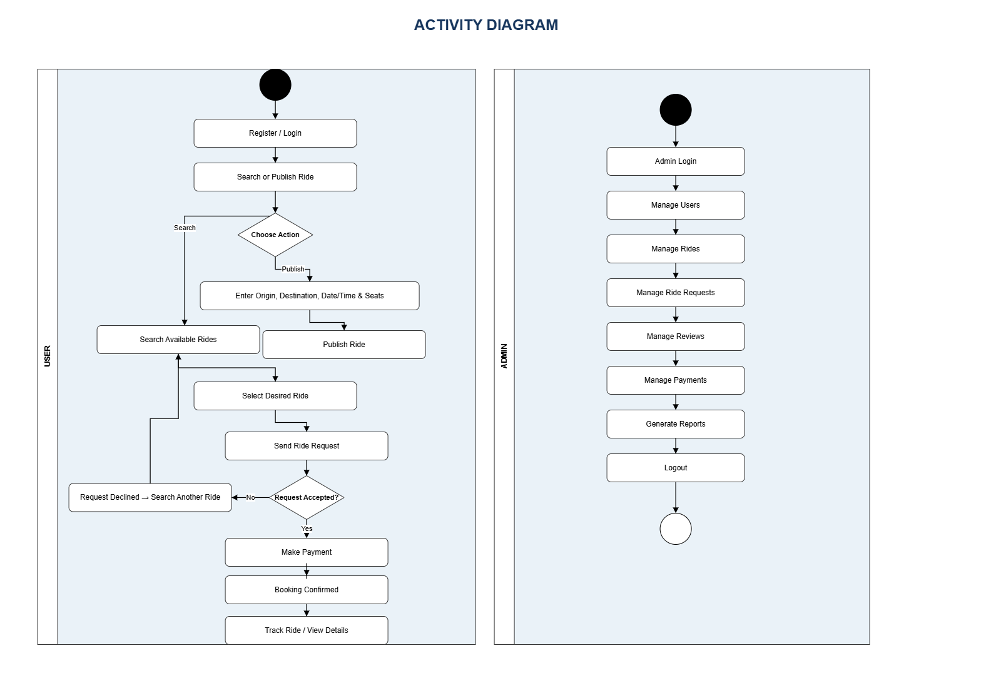
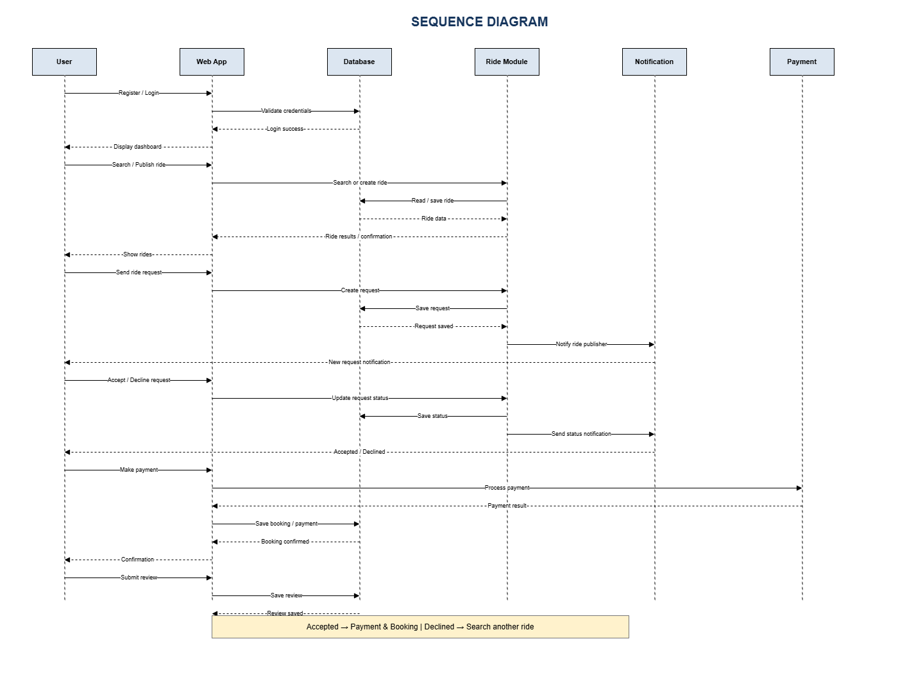
Design Diagrams
Data Flow Diagram (Level 0, Level 1 User / Admin)
Use Case Diagram
Class Diagram
Accepted
Booked
Pending
Declined
Search again
State Diagram (ride request)
Activity Diagram (User / Admin)
Sequence Diagram

Slide 14

Module Description
Registration & Authentication
Profile Management
Ride Publishing
Register and log in; authentication and authorization.
Manage profile and preferences; update personal details.
Publish rides with origin, destination, date, time, seats and fare; update or cancel.
Ride Searching
Ride Request Management
Notifications
Search by origin and destination; view available rides; select a ride.
Send requests, notify publisher, accept or decline, track status.
Alerts for requests, accept/decline decisions, booking and payment.
Reviews & Ratings
Payment Management
Administration
Submit reviews and ratings after a ride; view reviews.
Calculate fare, process payment, store records, show status.
Admin login; manage users, rides, requests, reviews; monitor payments.

Slide 15
Algorithm / Methodology
Application workflow
User registers or logs in
User publishes a ride or searches for rides
Seeker selects a suitable ride
Seeker submits a ride request
1
2
3
4
Publisher receives the request
Publisher accepts or declines
Request status and notifications are updated
Payment and review operations (where supported)
5
6
7
8
Iterative development methodology (sprints)
01
02
03
04
05
06
07
08
Requirement Analysis
System Design
Frontend Development
Backend Development
Database Implementation
Testing
Deployment
Maintenance & Enhancement

Slide 16
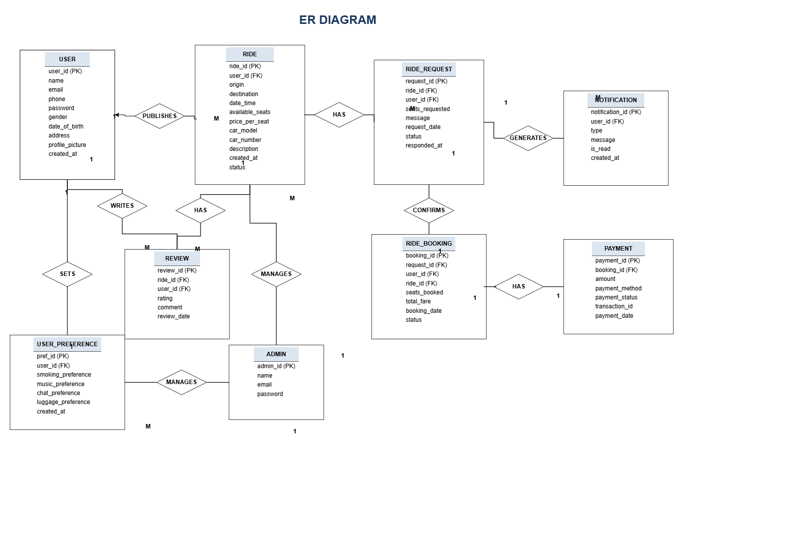
Implementation
Frontend
HTML5, CSS3, JavaScript pages; AJAX for dynamic updates.
Django backend
Views, business logic, authentication and admin features.
SQLite database
Accessed via Django ORM; entities follow the ER diagram.
Auth & profiles
Registration, login, profile with travel preferences.
ER diagram: database design
Publish & search
Publish rides; search by origin and destination.
Requests & alerts
Request → notify → accept/decline → status update; reviews and payments follow.

Slide 17

Results / Analysis
Implemented functionality (per project documentation)
Observed strengths
User registration and login
Publish, search, request and review in one platform
Structured request workflow with notifications
Simple interface, minimal training (feasibility study)
Profile and preferences
Ride publishing
Ride search by origin / destination
Ride requests with accept / decline
Observed weaknesses
Notifications
Four-wheeler rides only
Single-user model; no separate driver / passenger roles
No performance or user-study data collected yet
Reviews
Payments
Admin module
Quantitative benchmarking (response time, load, user studies) was not provided; this is a qualitative functional analysis.

Slide 18
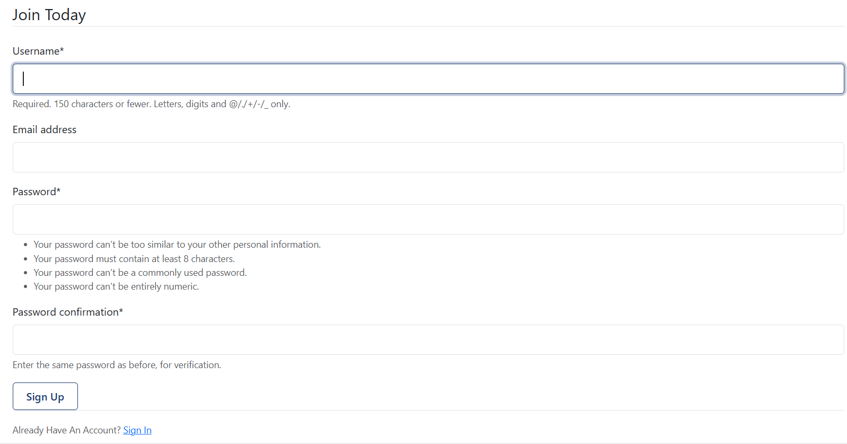
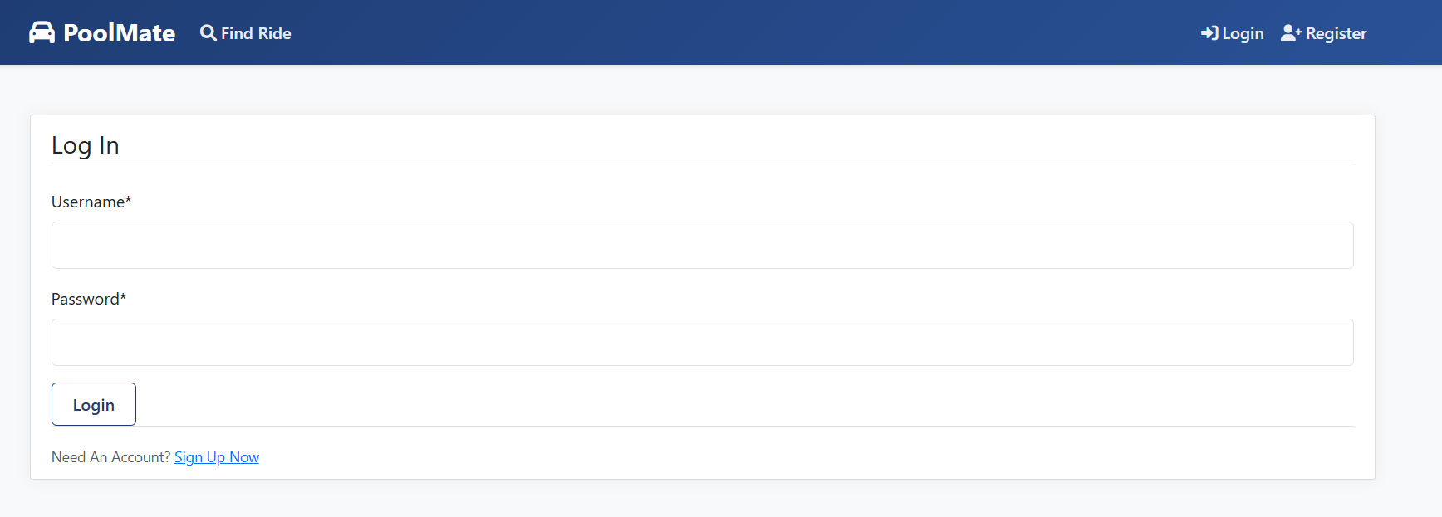
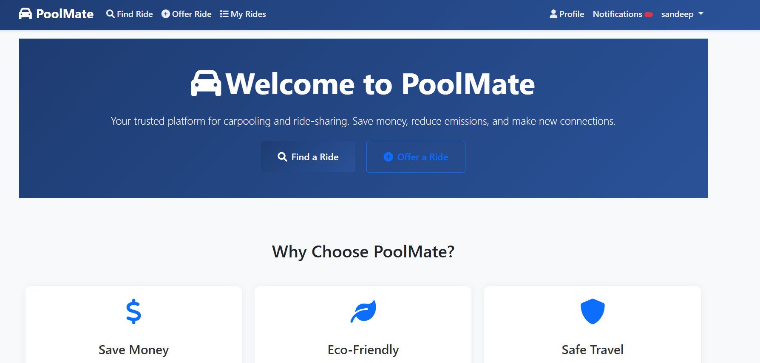
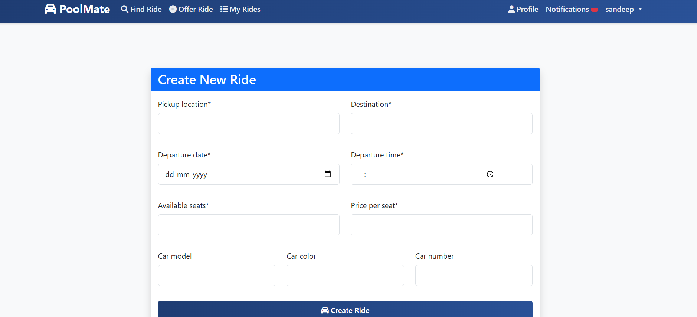
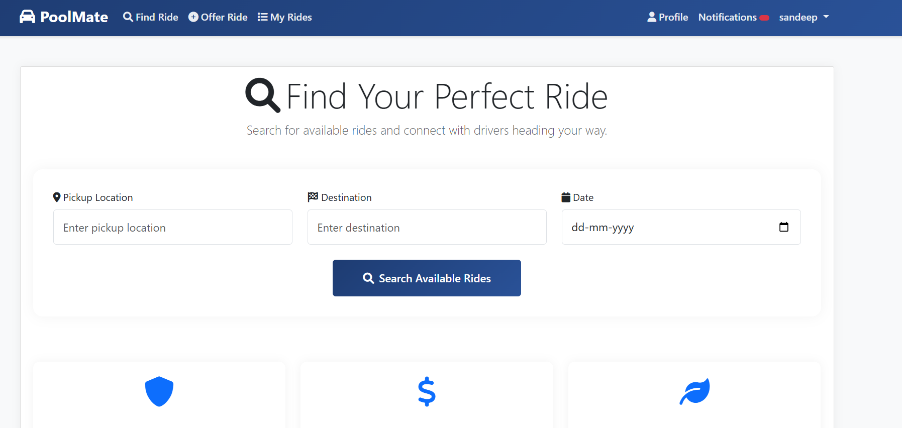

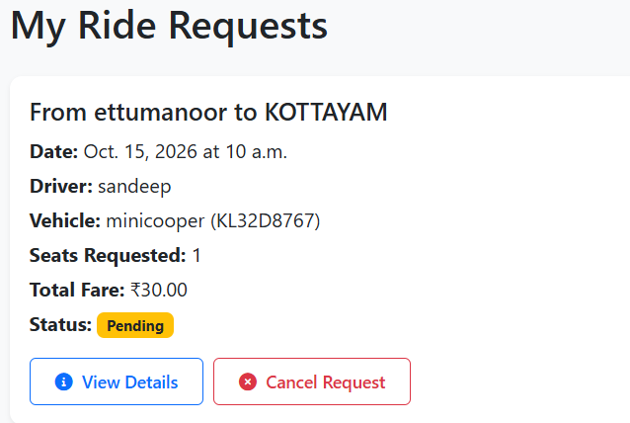
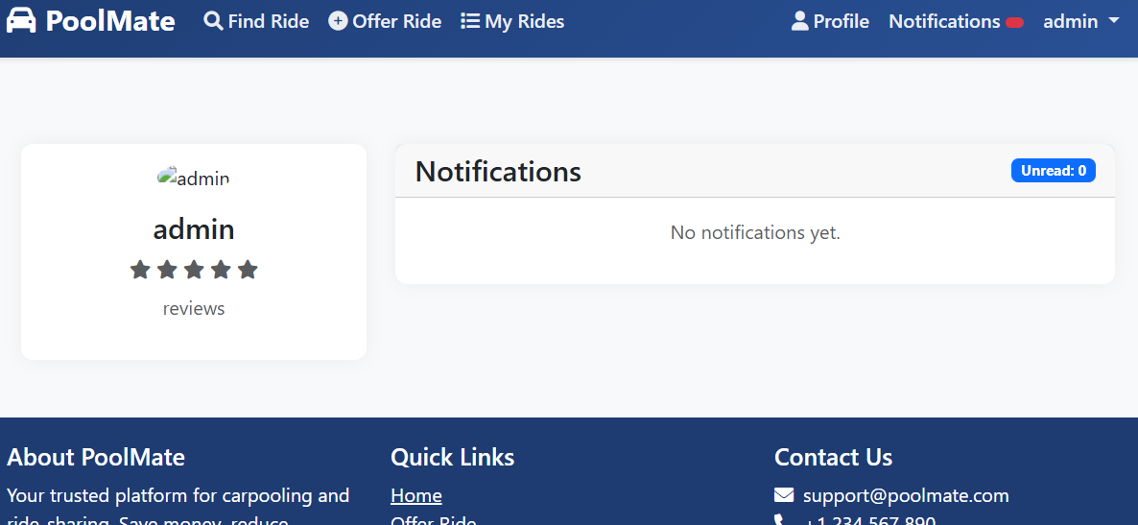
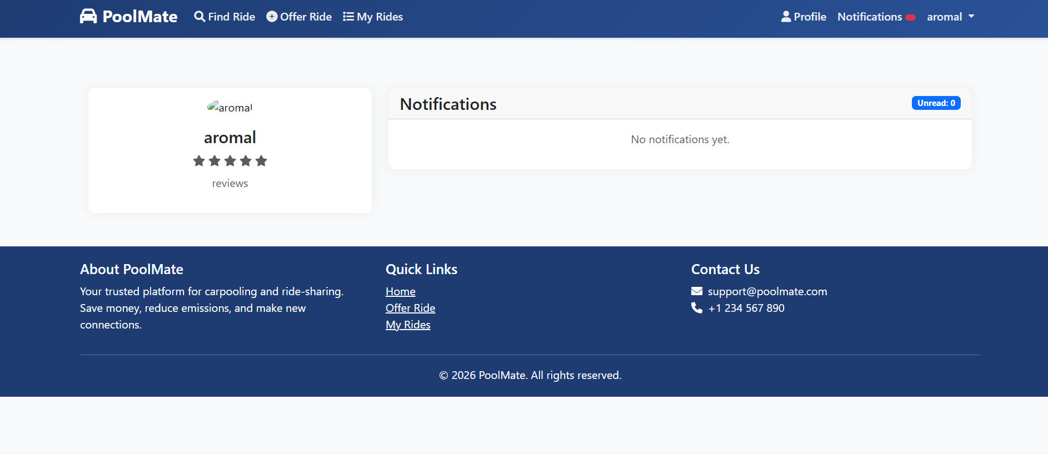
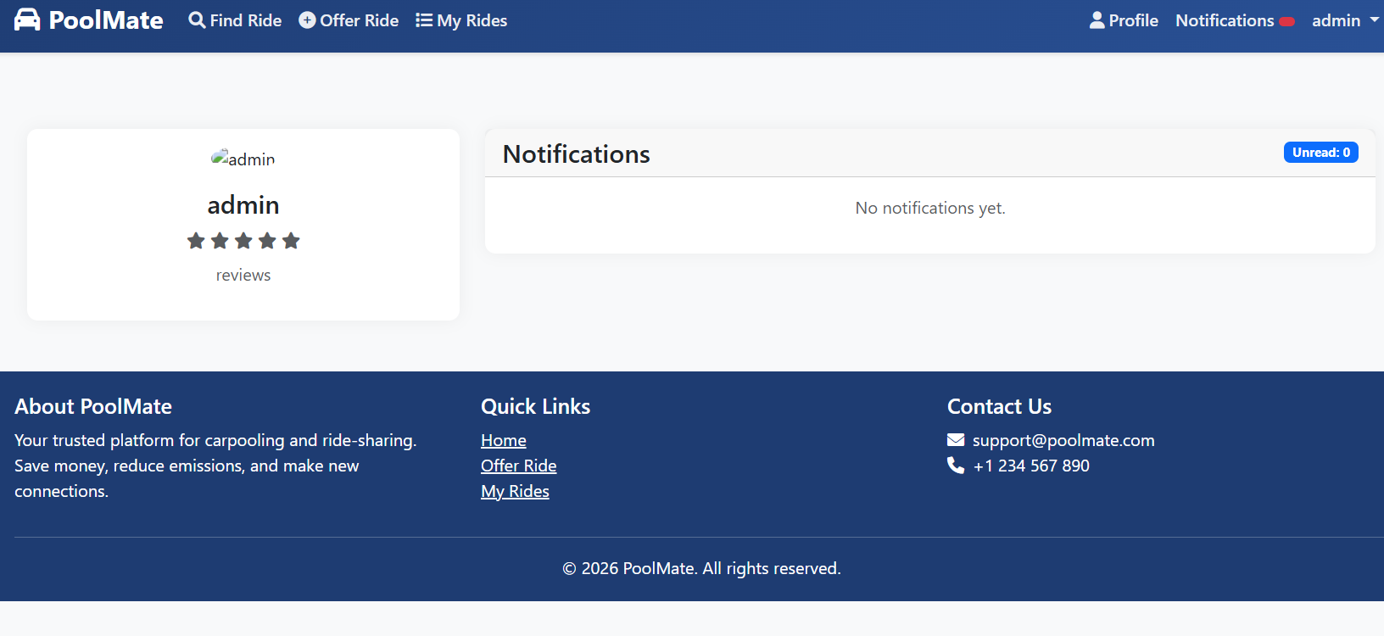
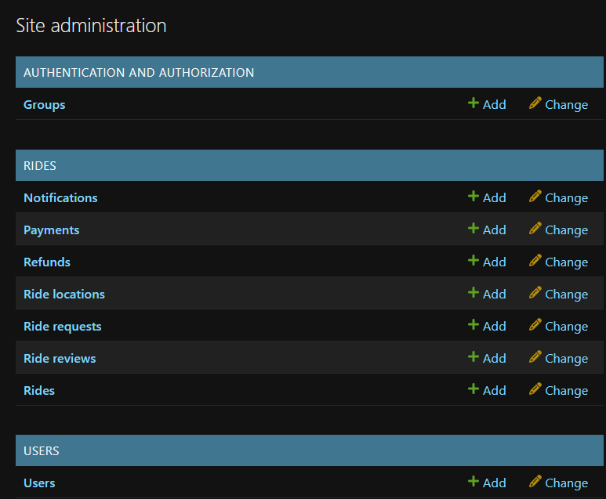
Screenshots / Output
[Insert screenshot]
[Insert screenshot]
[Insert screenshot]
[Insert screenshot]
[Insert screenshot]
Registration page
Login page
User dashboard
Ride publishing page
Ride search results
[Insert screenshot]
[Insert screenshot]
[Insert screenshot]
[Insert screenshot]
Ride-request interface
Notifications
Profile and review pages
Payment interface
Admin interface

Slide 19
Comparison with Existing System
Feature | Existing carpooling apps | POOLMATE
Ride model | BlaBlaCar: intercity focus. Uber Pool / Ola Share: company-owned cabs | Peer-to-peer four-wheeler sharing between registered users
Ride publishing & searching | Simple publish-and-search in one platform is lacking in most apps | Publish with origin, destination, time, seats; search by origin and destination
Request management | No integrated accept/decline workflow in most apps | Request → accept / decline with status update
Notifications | Not integrated into a single request workflow | Notifications for requests and decisions
Profiles & reviews | Quick Ride lacks a strong review/rating system; unified profile/review is lacking | Profile with preferences; reviews for rides and users
Payments | Not compared in this study | Payment for booked rides
Admin management | Not compared in this study | Admin module for users and reviews
Accessibility / usability | Not compared in this study | Web-based; simple interface (feasibility study)

Slide 20
Testing
Test Case | Expected Result | Actual Result | Status
Valid login | Login successful; dashboard shown | successful | pass
Invalid login | Error message displayed | successful | pass
User registration | Account created with valid details | successful | pass
Ride publishing | Ride saved and listed | successful | pass
Ride searching | Matching rides listed by origin / destination | successful | pass
Send ride request | Request saved; publisher notified | successful | pass
Accept / decline request | Status updated; seeker notified | successful | pass
Notifications | Shown on requests and decisions | successful | pass
Review submission | Review saved and visible | successful | pass
Payment operation | Payment recorded; status shown | successful | pass

Slide 21
Demo Video
1
Login
2
Publish a ride
3
Search for a ride
4
Submit a ride request
5
Accept or decline the request
6
Show other features (notifications, review, payment, admin)

Slide 22


Advantages
Convenient coordination
Shared expenses
Simple publish and search
Structured requests
Publish and find rides in one place.
Travel cost is split among co-travellers.
Origin, destination, time and seats.
Accept / decline with clear status.
Better coordination
Trust building
Fewer vehicles (potential)
Notifications keep both sides informed.
Profiles and reviews help co-travellers trust each other.
When users genuinely share rides, fewer cars are needed.

Slide 23
Limitations
CONFIRMED (CURRENT SCOPE)
POSSIBLE FUTURE CONCERNS (NOT TESTED)
Four-wheeler carpooling only
Single-user model: no separate driver / passenger roles
Works only when users publish rides
Matching depends on suitable origin, destination and time
No performance benchmarking or user study yet
Adoption and ride availability depend on community size
SQLite may limit scalability for many concurrent users
Identity verification and extra safety features are not covered yet
Confirmed limitations come from the current project scope. Possible concerns are expectations that have not been tested.

Slide 24

Conclusion
Problem
Solution
Functionality
Technologies
Contribution
No simple platform for sharing four-wheeler rides and managing requests with trust.
POOLMATE: publish, search, request, accept / decline and notify in one web platform.
Registration, profiles, ride publishing and search, requests, notifications, reviews, payments, admin.
HTML, CSS, JavaScript, AJAX; Python and Django; SQLite.
Makes ride sharing more convenient and cost-effective for users.
POOLMATE delivers a structured, easy-to-use foundation for convenient ride sharing.

Slide 25



Future Scope
Proposed enhancements – none of these are implemented yet
Maps and GPS
Improved ride matching
Real-time tracking
Enhanced notifications
Map-based routes and locations.
Better matching of rides and seekers.
Live location of an ongoing ride.
Email / SMS alerts.
Verified identities
Better payments
Mobile application
Safety and trust
Stronger trust between users.
Improved payment integration.
Android / iOS support.
Additional safety features.

Slide 26
References
[1] Xiaoming Li et al., “Ride-sharing matching under travel time uncertainty,” IEEE Access, 2022.
[2] “QE-Ride,” IEEE, 2024. [3] “i-CAP intelligent carpooling,” IEEE, 2023.
[4] “ML-based ride recommendation,” Springer, 2024.

Slide 27
Thank You
POOLMATE – Web-Based Carpooling Platform
Sandeep Kumar VS | MCA (S3) | Department of Computer Applications

